Slide 1
Division of Undergraduate Education
Town Hall
Wednesday, April 24 | 12:00 – 1:00 pm
Brian Utter, Interim VPDUE
Holley Moyes, Assoc. Dean and University Honors Faculty Director
Justin Hicks, Assoc. Dean and Interim Chair of General Education Executive Committee

Slide 2
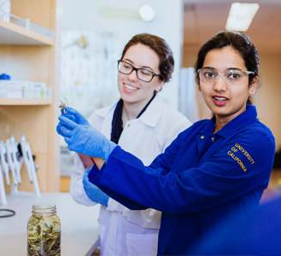
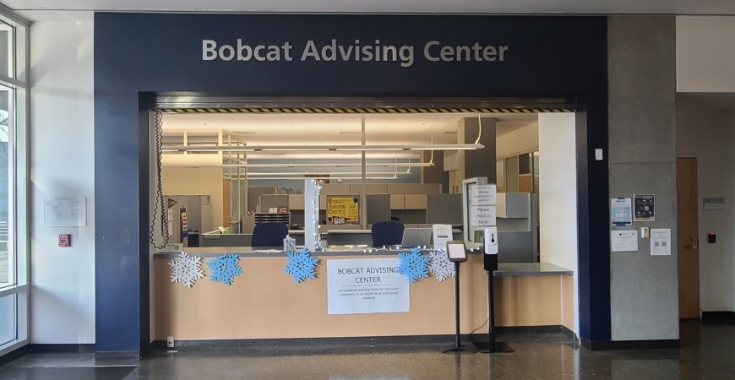
Division of Undergraduate Education Overview
Undergraduate Research Opportunities Center (UROC)
Bobcat Advising Center
Student Learning Centers (STEM Tutoring Hub, Writing Center & PLUS Center)

Slide 3
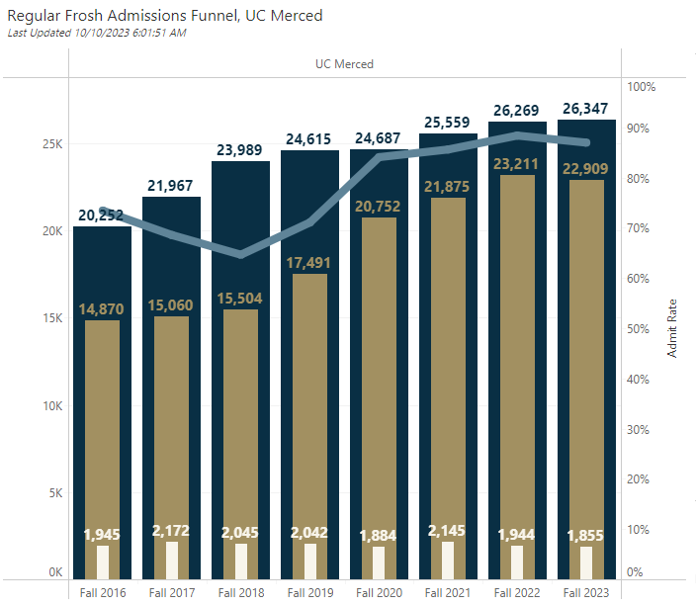
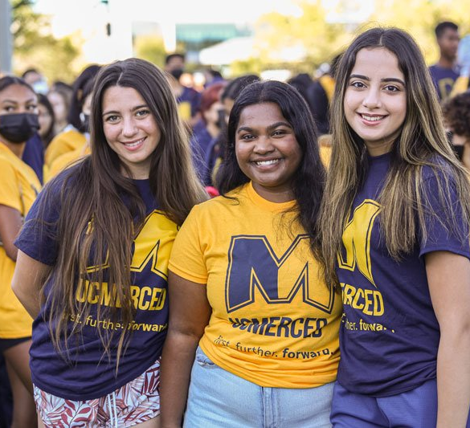
Division of Undergraduate Education Overview
Center for Engaged Teaching and Learning
Undergraduate Education Assessment
Student Success Initiatives

Slide 4
Division of Undergraduate Education Overview
Summer Session
General Education
University Honors Program

Slide 5
University-Wide Curriculum and DUEEC
Bylaws passed effective today establish the DUE Executive Committee to manage campus-wide curricular programs.
College One
VPDUE
DUEEC
University
Honors
Program
GE
Program
USTU
(Undergraduate Studies)

Slide 6
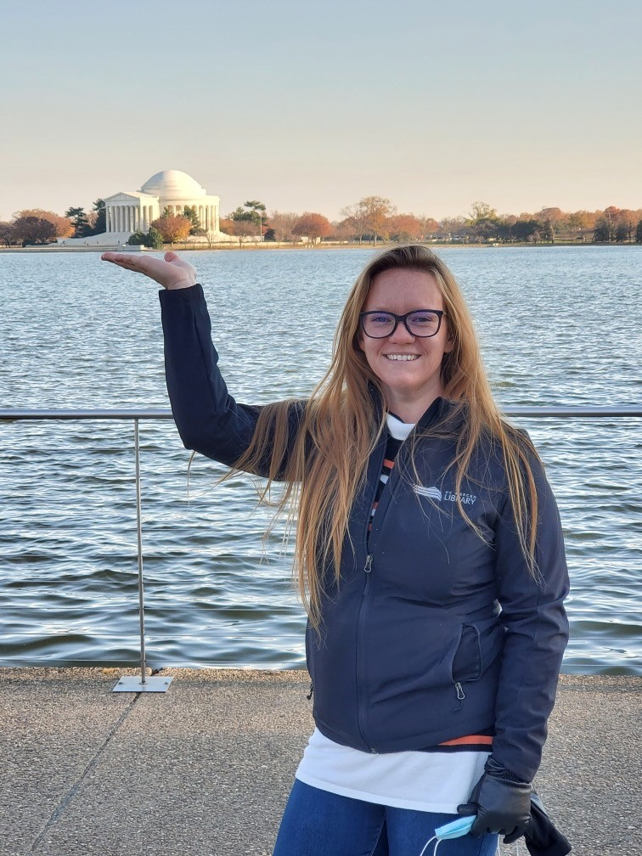
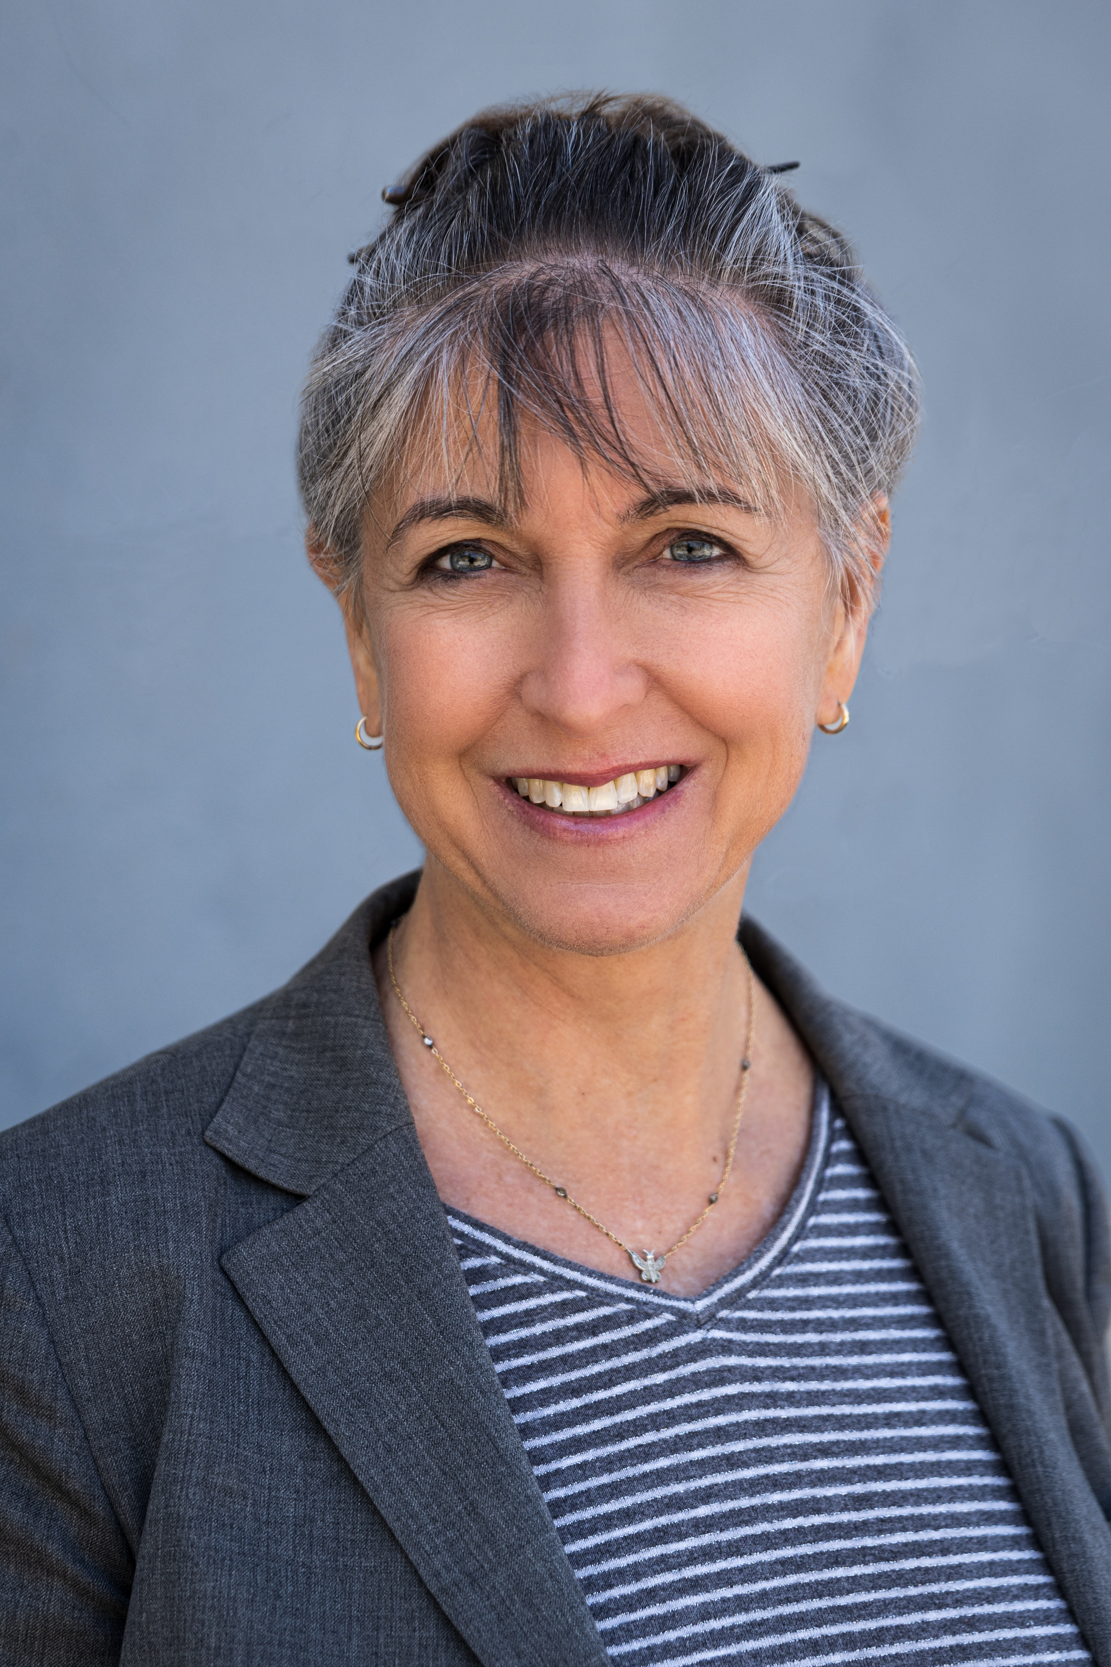
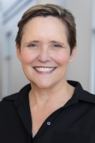
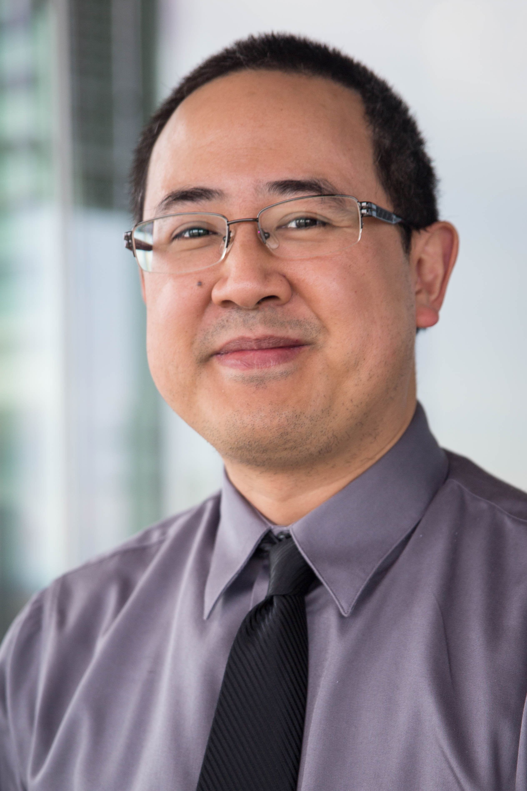
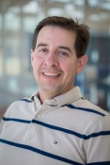
Honors Interim Executive Committee
Sunni Nelson, Honors Program Coordinator
Holley Moyes, Honors Program Faculty Director
Associate Dean of Undergraduate Education
Anthropology & Heritage Studies (SSHA)
Valerie Leppert, Professor
Materials Sciences and Engineering (SoE)
Jason Lee, Associate Teaching Professor
Economics and Business Management (SSHA)
Rudy Ortiz, Professor
Molecular Cell Biology (SNS)

Slide 7
In 2021, Undergraduate Council (UGC) set up a working group to design and implement a new program that would provide academically talented and motivated students with an enriched environment to be creative and innovative, develop leadership skills, and become effective global citizens and community partners.

Slide 8
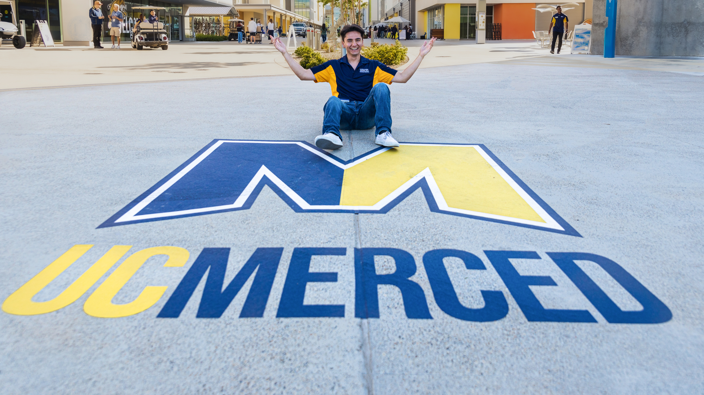
According to the UCM Office of Admissions:
17% of responses on the “SIR no” survey in both Fall 2020 and Fall 2021 (about 550 students in both years) responded that they did not SIR at UCM because there was no honors program.
First Generation applicants (24%) mentioned the lack of an honors program much more often than Non-First-Generation applicants (10%)
Campus-wide Honors:
Good for the University

Slide 9
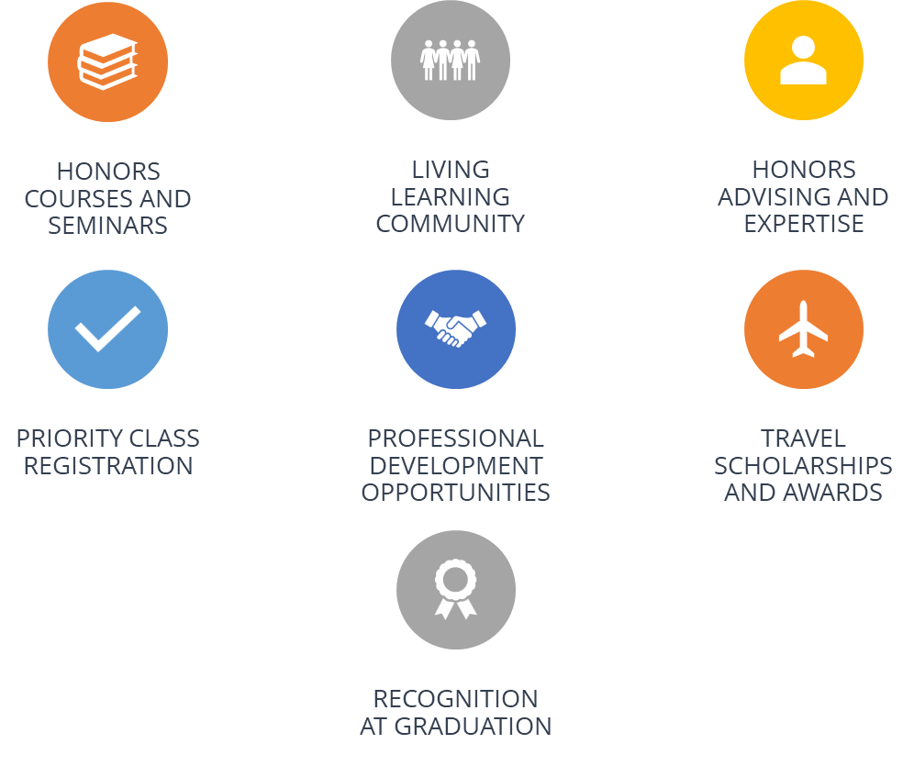
Benefits

Slide 10
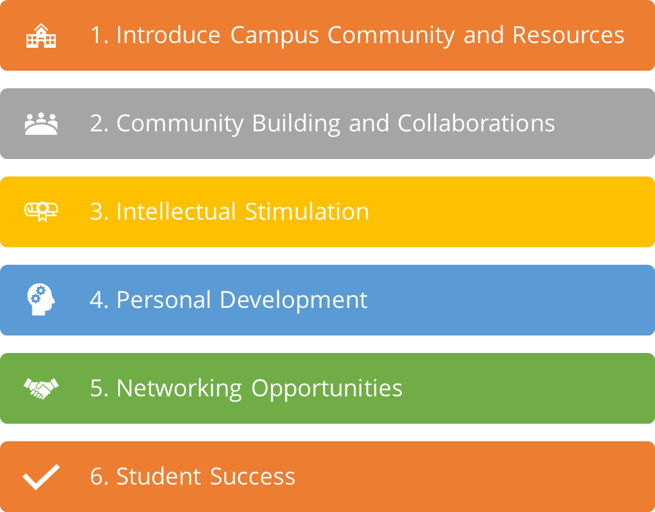
Living Learning Community
UHP LLC will be housed in El Portal
All first-year Honors Scholars living on campus are expected to live in the UHP LLC.

Slide 11
2023-2024 University Honors Program Updates – Inaugural Cohort
Admissions
Application Criteria
Included 5 questions along with a creative product and reflection.
Holistic review
Friday, April 12, 2024
Honors Interim EC finished reviewing 309 applications and selected top applicants for UHP.
Wednesday, April 17, 2024
Invited 92 applicants to join our inaugural cohort for Fall 2024
As of today, we have 14 students who accepted our invitation
Outreach
Saturday, April 20, 2024
Attended Bobcat Day and presented to prospective Honors Scholars and guest.
Assisted 19 prospective Honors Scholars and their family members.

Slide 12
Program Requirements
First-year Students
4 Honors Seminars (one-unit)
5 Honors Courses
(2 must be Honors Designated-General Education Courses)
Experiential Learning
Internships, Summer Undergraduate Research Institute (SURI), UROC, External Research Experiences for Undergraduates (REUs), UCDC Program, UCCS Program, Study Abroad, Fieldwork, or Supervised Research
Community, Mentorship and Leadership
Campus Tutoring, Peer Success Mentor Program, Community Service, ASUCM, Leadership Position in a Registered Campus Club or Organization, Yosemite Leadership Program, or similar activities in consultation with the Honors Faculty Director.

Slide 13
How can you participate?
Join our Faculty or Affiliates
Offer a Course
Mentor Honors Students
Expedited Curriculog process for existing courses adding the Honors designation
Honors Contracts can be any course currently taught by an Honors Program faculty member. It is designed to allow students to pursue individualized work within the framework of a non-honors class. It allows students to take a leadership role in their education by driving key aspects of the content of their learning.
The student and faculty member will work together to create a contract.
Examples include:
A traditional research paper or elevated class paper
A case study
A specialized lab experiment
Please visit our website at honors.ucmerced.edu for more information!
Show your support by joining our Honors Faculty or Honors Affiliates

Slide 14
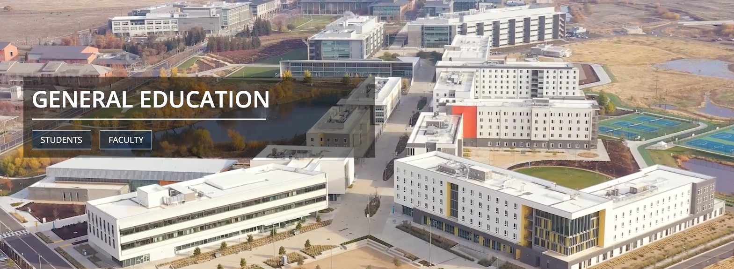
General Education – ge.ucmerced.edu

Slide 15
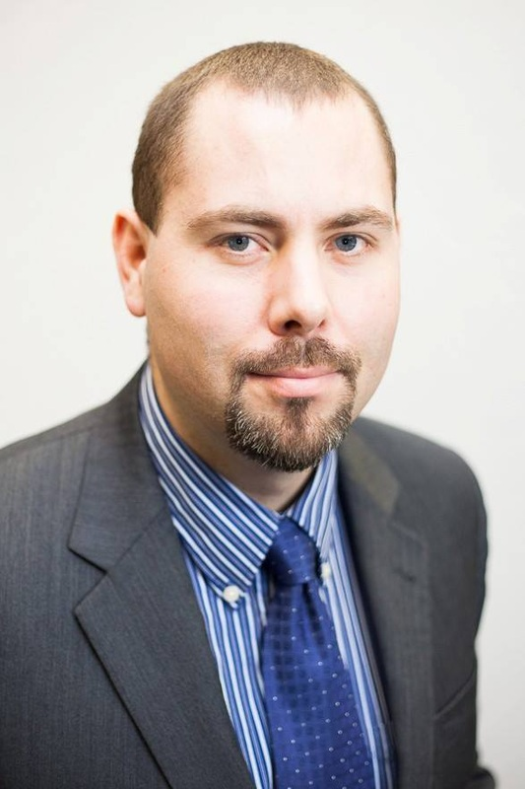
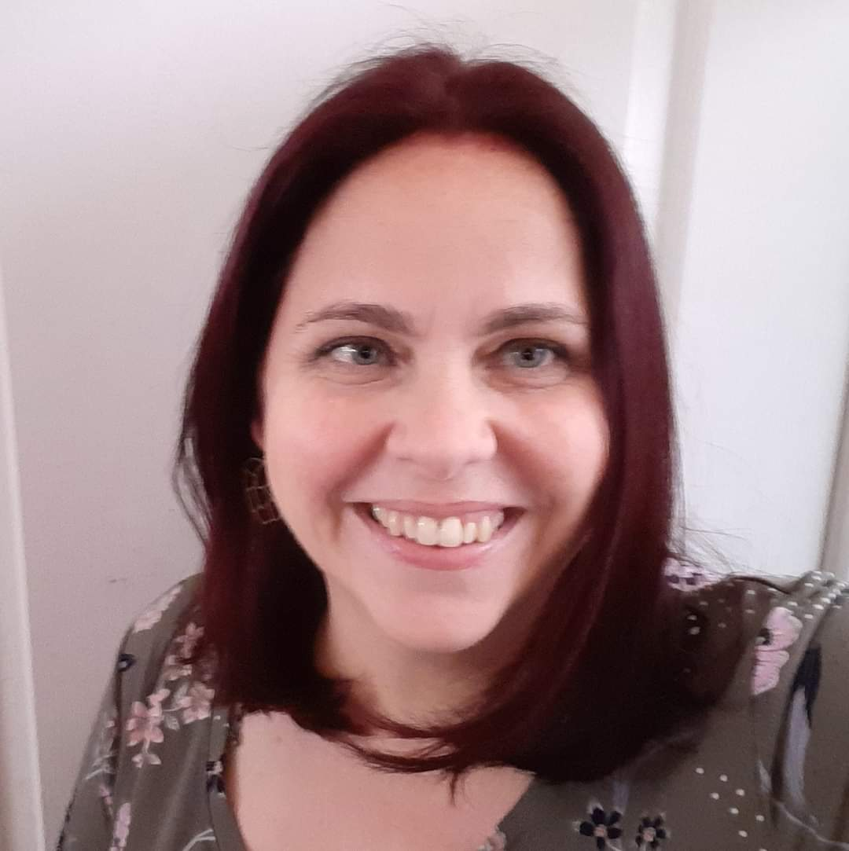
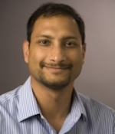
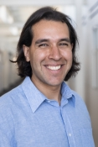
General Education Executive Committee AY 23-24
Alejandro Gutierrez
Associate Teaching Professor,
Mechanical Engineering
Ryan Baxter
Associate Professor and
Department Chair
Chemistry & Biochemistry
Justin Hicks
Interim GEEC Chair,
Associate Dean of
Undergraduate Education,
Associate Teaching Professor,
Economics
Heather Devrick
Continuing Lecturer,
Merritt Writing Program
Sachin Goyal
Associate Teaching Professor,
Mechanical Engineering

Slide 16
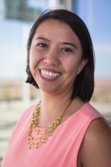
Call for GE committee members for AY 24-25
SSHA rep
Ryan Baxter
SNS rep
Sachin Goyal
SoE rep
Heather Devrick
Unit 18 Lecturer
SSHA rep
Stephanie Woo
SNS rep
Alejandro Gutierrez
SoE rep
Unit 18 Lecturer

Slide 17
General Education Updates
Ongoing Initiatives
AY 23-24 – Implementation of GE requirement changes
Approaches to Knowledge A & B
Life & Physical Science
MVA, LTA, SCP
Formalizing Assessment
Programmatic Reviews in conjunction with PROC departmental self-studies
Annual Assessment of GE Learning Outcomes
GE Program Review will begin in spring 2025
Program Refinement / Spark Proposals
GE Designations Review and Refinement
Diversity & Identity and Scientific Method done
Global Awareness, Ethics, Sustainability in progress
Refined designations guidance for curriculum proposals

Slide 18
Before Fall 23
21 requirements
Fall 23 Implementation
17 requirements
Lower Division Common Course Requirements
Spark Seminar
Written Communication
Quantitative Reasoning
Language
Upper Division Common Course Requirements
Crossroads Course
Writing in the Discipline
Culminating Experience
AREA A: Natural & Engineering Science – 3 courses
Approaches to Knowledge: Natural Science
Approaches to Knowledge: Engineering Science
AREA B: Social Science, Arts & Humanities – 3 courses
Approaches to Knowledge: Social Science
Approaches to Knowledge: Arts & Humanities
Badges
Scientific Method
Diversity and Identity
Global Awareness
Sustainability
Ethics
Literary and Textual Analysis
Media and Visual Analysis
Societies and Cultures of the Past
Lower Division Common Course Requirements
Spark Seminar
Written Communication
Quantitative Reasoning
Language
Upper Division Common Course Requirements
Crossroads Course
Writing in the Discipline
Culminating Experience
AREA A: Life and Physical Science – 2 courses
Approaches to Knowledge: Life Science
Approaches to Knowledge: Physical Science
AREA B: 3 courses: 1 Social Science, 2 of 3 Literary & Textual Analysis, Media & Visual Analysis, Societies & Cultures of the Past
Approaches to Knowledge: Social Science
Approaches to Knowledge: Literary and Textual Analysis
Approaches to Knowledge: Media and Visual Analysis
Approaches to Knowledge: Societies and Cultures of the Past
Intellectual Experiences
Scientific Method
Diversity and Identity
Global Awareness
Sustainability
Ethics

Slide 19
Q & A

