Slide 1
Logic Modeling: Analyzing and Communicating Contributions to First Year Student Success
Theory
Outcomes
Impact
Resources
Program Activities
Outputs
Laura E. Martin, Director
Office of Periodic Review, Assessment, and accreditation Support
Amy Moffat, Assessment Manager
School of Natural Sciences
First Year Student Success Workshop June 23, 2016
Notes:
ask how many people have experience with logic models?

Slide 2
Session Outcomes
By the conclusion, you should be able to
Identify one way a logic model can contribute to
articulating / visualizing your program
illustrating your program’s contribution to first year student success
Initiate a logic model for your program
Propose an assessment process for one outcome from your logic model
Identify resources to help with logic modeling
Notes:
So goal is 20-25 min intro to logic model through the assessment cycle
Work on models and reflection questions at tables over lunch (1 hour – with other facilitators)
Debrief experience
Close with resource slide.

Slide 3
Schedule
11:30 – 12:00 Introduction to Logic Model
12:00 – 1:00 Working Lunch and Logic Model Practice
1:00 – 1:20 Reflection and Logic Model Debrief

Slide 4
The Context
Notes:
Before we get to logic models want to set the scene a bit…..

Slide 5
Premise 1
Mandatory Student Success Session at ASCEND Conference
90% of first year students are in good academic standing at conclusion of first semester
It is unlikely that a program/intervention/experience can be expected to impact first year student success as measured by an institutional metric.
Notes:
Sometimes we are mistaken to think that this is the logical order….

Slide 6
Premise 1
Mandatory Student Success Session at ASCEND Conference
90% of first year students are in good academic standing at conclusion of first semester
It is unlikely that a program/intervention/experience can be expected to impact first year student success as measured by an institutional metric.
Notes:
Why does this not work?
Get room to talk about why this scenario is not logical.
This leads to premise 2.

Slide 7
Premise 2
Programs and support services typically address one facet of student journeys, and thus contribute to but are not wholly responsible for student success.
Good Academic Standing
Notes:
Achievement of an institutional goal requires diverse interventions to address student experience.
Identify needs of particular populations
Match interventions
Recognize that even within populations student experiences are diverse and will need diversity of support forms.
Riciprocally --- many factors influence the success of any individual student.
Maybe have them talk about the many things that influence the success of a single student over the course of a semester. It’s having the right resourceS at the right timeS……

Slide 8
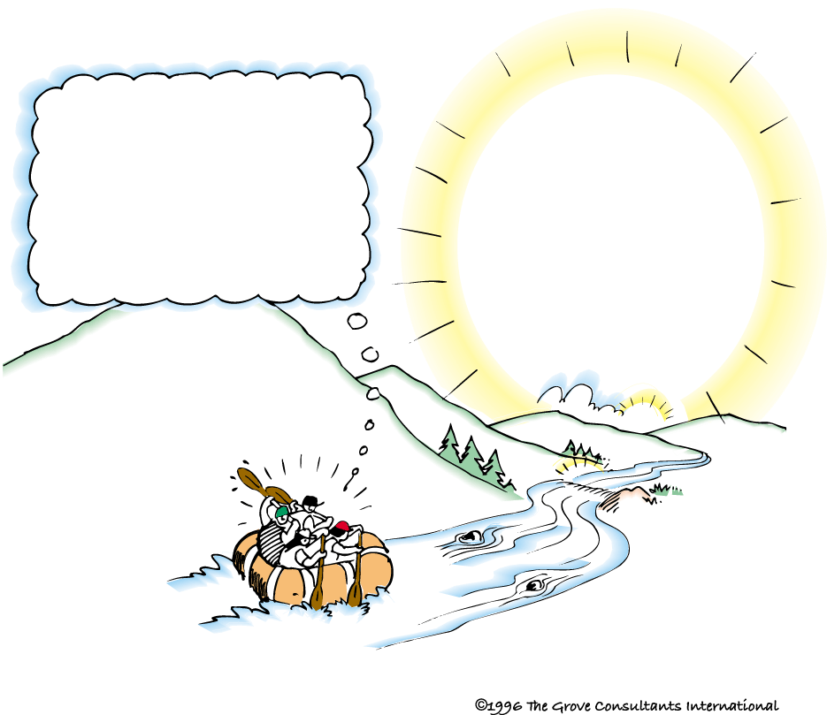
Premise 3
Student success is….
an institutional effort
the result of multiple complementary programs collectively addressing the needs of students (student populations) in relation to a shared intended outcome (e.g. good standing at the end of the first semester).
Notes:
This brings us to our metaphor of….. Many paddle rowing in the same direction.
Each paddle is a program/intervention/experience helping move students toward the goal of staying at UC Merced, being in good academic standing, and achieving their goals, including their degrees.
Each paddle is well designed….. The RIGHT RESOURCES = a well designed intervention or program. = intentional program design
We also want a complementary set of paddles.
Students benefit from more than one paddle – i.e. more than one program or intervention or support service that are intentionally designed to support progress toward a common outcome.
From an institutional perspective also want to make sure that all students are in the boat. I.e. there aren’t students who aren’t benefitting from any paddles. I.e. there are students who don’t have access to or aren’t accessing the right programs/services/interventions.
So how do we design an effective paddle?
Logic model

Slide 9
We are all in the boat padding (with) students toward success. What does your paddle look like?

Slide 10
Logic Model
Designing a Paddle

Slide 11
Logic Model: A series of proposals to generate a desired impact.
Theory/Assump-tions
Outcomes
Impact
Resources
Program Activities
Outputs
Logic models are presented, not developed, in this order.
Using Logic Models to Bring Together Planning, Evaluation, and Action Logic Model Development Guide. Kellogg Foundation. 2004. Retrieved from http://www.smartgivers.org/uploads/logicmodelguidepdf.pdf
Notes:
Lots of different kinds of logic models but offer here a common structure to work from so that we can all communicate with each other. Share logic models that explain our programs. Illustrate our paddles - their shape, who they support, what campus goals they support.

Slide 12
Many kinds but a single example
Rationale: A consistent campus approach to logic modeling facilitates
Interpreting each other logic models
Linking logic models to assessment
Aligning unit efforts in support of a campus goal like retention

Slide 13
Some Logic Model Definitions for UCM
Theory/Assump-tions
Outcomes
Impact
Resources
Program Activities
Outputs
1. The fundamental change occurring in an organization (i.e. UCM).
E.g. High rate of good academic standing at end of the first semester.
Notes:
Lots of different kinds of logic models but here a common structure to work from so that we can all communicate.
Move between slides and example from summer bridge.
Go through it direction from which might develop it.
Start with the institutional goal or end in mind.
Start the end in mind…. Impact. Make BIG.
This is what our programs or paddles are contributing to. It’s the goal toward which the raft is paddling and carrying students.

Slide 14
Some Logic Model Definitions for UCM
Theory/Assump-tions
Outcomes
Impact
Resources
Program Activities
Outputs
2. Theoretical ideas, local context, and or operating principles that underpin the program/intervention.
What the literature says works.
The local reasons (data, context, etc.) for thinking the literature-based solution could work here and rationale for any local modifications.
Principles and/or values that guide the design of the program.
1. The fundamental change occurring in an organization (i.e. UCM).
E.g. High rate of good academic standing at end of the first semester.
Notes:
Lots of different kinds of logic models but here a common structure to work from so that we can all communicate.
Move between slides and example from summer bridge.
Start the end in mind…. Impact. Make BIG.
This is what our programs or paddles are contributing to. It’s the goal toward which the raft is paddling and carrying students.

Slide 15
Some Logic Model Definitions for UCM
Theory/Assump-tions
Outcomes
Impact
Resources
Program Activities
Outputs
2. Theoretical ideas, local context, and or operating principles that underpin the program/intervention.
3. The human, financial, and institutional resources needed to operate the program.
1. The fundamental change occurring in an organization (i.e. UCM).
E.g. High rate of good academic standing at end of the first semester.
Notes:
Resources - [brief, ask to call out… examples.]

Slide 16
Some Logic Model Definitions for UCM
Theory/Assump-tions
Outcomes
Impact
Resources
Program Activities
Outputs
2. Theoretical ideas, local context, and or operating principles that underpin the program/intervention.
3. The human, financial, and institutional resources needed to operate the program.
4. The structure of the program in the form of planned activities. Events, actions, processes that constitute the program.
1. The fundamental change occurring in an organization (i.e. UCM).
E.g. High rate of good academic standing at end of the first semester.

Slide 17
Some Logic Model Definitions for UCM
Theory/Assump-tions
Outcomes
Impact
Resources
Program Activities
Outputs
2. Theoretical ideas, local context, and or operating principles that underpin the program/intervention.
3. The human, financial, and institutional resources needed to operate the program.
4. The structure of the program in the form of planned activities. Events, actions, processes that constitute the program.
5. Direct products of program activities in the form of quantitative descriptions of how and to whom program activities are or will be delivered. E.g. frequency of activities, participant numbers, participant demographics, etc.
1. The fundamental change occurring in an organization (i.e. UCM).
E.g. High rate of good academic standing at end of the first semester.
Notes:
OUTPUTS:
Referring to the literature we read for today (Whitt 2006, p. 4)… “Offering an array of opportunities for involvement from which students can choose DOES NOT constitute a meaningful student affairs confirbution to student learning. Students have to USE the resources of the setting in order to realize their benefits.”
We ask the question: Did the right people participate in the right numbers?

Slide 18
Some Logic Model Definitions for UCM
Theory/Assump-tions
Outcomes
Impact
Resources
Program Activities
Outputs
2. Theoretical ideas, local context, and or operating principles that underpin the program/intervention.
3. The human, financial, and institutional resources needed to operate the program.
4. The structure of the program in the form of planned activities. Events, actions, processes that constitute the program.
5. Direct products of program activities in the form of quantitative descriptions of how and to whom program activities are or will be delivered. E.g. frequency of activities, participant numbers, participant demographics, etc.
6. The behaviors, knowledge, skills, attitudes, etc. the program activities are designed to demonstrably engender. I.e. the learning outcomes.
1. The fundamental change occurring in an organization (i.e. UCM).
E.g. High rate of good academic standing at end of the first semester.
Notes:
OUTCOMES:
We ask the question: Did participants demonstrably learn what was intended?

Slide 19
Logic Models & Assessment
Is your paddle effective?

Slide 20
4. Gather and review evidence of student learning.
6. Act on the results to improve student achievement of learning goals
1. Establish and make public goals for student learning. Expressed as learning outcomes, criteria and standards.
2. Determine the evidence. What work will students do to demonstrate learning?
3. Provide intentional learning experiences: Curriculum and pedagogy.
5. Draw conclusions about student learning achievements in the aggregate
Assessment +
Logic Model
Theory/
Assumptions
Outcomes
Impact
Resources
Program Activities
Outputs
Did participants demonstrably learn what was intended?
Assessment Cycle
Intended participant audience, rates, etc. Variables describing to whom and how the program is delivered in detail
Did the right people participate in the right numbers?
OPRAAS DRAFT
Notes:
Make connection between outputs and outcomes and outcomes assessment
Look at summer bridge example of steps 1,2,3 for assessment

Slide 21
Your turn to practice
In groups of three, at your table:
Develop the logic model for a program described in Round Table 1, using the logic model template. Working from the outcomes, describe
The outcomes
The outputs
The program activities
Chose one outcome and complete the assessment cycle on the back to plan how you would assess it.
Notes:
Explain what do over lunch hour.
Highlight working backwards.

Slide 22
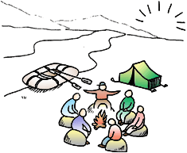
Reflection Questions
What is one thing you find helpful about logic models?
What one question do you have about logic modeling and/or assessment?

Slide 23
Power of Logic Models
Facilitate alignment of all elements of a program to increase likelihood of achieving intended outcomes and contributing to impact
Clarify the program’s contribution to institutional priorities
Illustrate and communicate program’s contribution to institutional goals
Analyze program effectiveness with a focus on intended audience and intended outcomes
Theory
Outcomes
Impact
Resources
Program Activities
Outputs
Notes:
Analysis of program effectiveness. If the learning outcomes weren’t met, why? If the program isn’t serving the intended students in the intended number can it be serving its intended role?

Slide 24
Help with Logic Modeling
Amy Moffat, amoffat@ucmerced.edu
Penny Paxton, ppaxton@ucmerced.edu
Corinne Townsend, ctownsend@ucmerced.edu
Kristin Hublik, khublik@ucmerced.edu
Laura Martin, lmartin@ucmerced.edu
Theory
Outcomes
Impact
Resources
Program Activities
Outputs

